Slide 1


Since 2011
Our outcomes are over 5000 trainees.
Get IT Right from RIG

Slide 2

Artificial Intelligence Engineering
(Level-1)
Learn, Create, and Shine
Digital Space

Slide 3
Level-1
Module 1: Introduction to AI and Machine Learning
Module 2: Linear Algebra, Statistics and Probability for AI
Module 3: Neural Network Architecture
Module 4: Building Machine Learning Models
Module 5: Deep Learning Concepts
Module 6: Python Data Structure
Module 7: Data Handling with Pandas and NumPy
Module 8: Python for AI
Module 9: Classification AI Project
Module 10: Prediction AI Project

Slide 4
Artificial Intelligence Engineering
(Level-1)
Module 5: Deep Learning Concepts

Slide 5
Content
Deep Learning Concepts
Why Deep Learning needs?
Deep Learning Architecture
How Convolutional Neural Network Works?

Slide 6
Learning Outcomes
Deep Learning Concepts: Understand the fundamental principles and key characteristics of deep learning.
Why Deep Learning is Needed: Analyze the importance of deep learning in solving complex problems and its advantages over traditional machine learning methods.
Deep Learning Architecture: Identify and explain the components and structure of deep learning models, including layers, activations, and backpropagation.
How Convolutional Neural Network Works: Demonstrate knowledge of CNN operations, including convolution, pooling, and how they are used for image recognition tasks.

Slide 7

Deep Learning Concept
Definition: A subset of Machine Learning focused on neural networks with many layers (deep neural networks).
Real-Life Examples:
Image Recognition (Face Detection)
Natural Language Processing (Chatbots)
Self-Driving Cars
Notes:
Deep Learning aims to simulate how the human brain works by using artificial neural networks to learn patterns and make predictions. Unlike traditional ML, it excels in handling complex data like images, text, and speech.

Slide 8
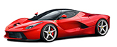
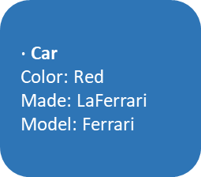
Why Deep Learning needs?
Solves complex problems with high accuracy.
Requires less feature engineering.
Can process unstructured data (images, audio, text).
Input
Less feature engineering
Output
$∙$ Car
Color: Red
Made: LaFerrari
Model: Ferrari
Image
Hidden neurons
To Read: https://addepto.com/blog/deep-learning-architecture/
Notes:
Solves complex problems with high accuracy.
Reduces feature engineering by automatically learning features from data.
Processes unstructured data like images, audio, and text effectively.

Slide 9
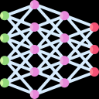
Deep Learning Architecture
Overview
Feedforward Neural Networks: Basic neural network structure.
Convolutional Neural Networks (CNNs): Best for image data.
Recurrent Neural Networks (RNNs): Ideal for sequential data (time series, text).
Generative Adversarial Networks (GANs): Used for generating data (synthetic images).
Deep Learning
Notes:
FNN
CNNs
RNNs
GANs

Slide 10
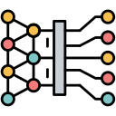
Understanding CNNs
Convolutional Neural Networks (CNNs) are a type of deep learning model specifically designed for processing grid-like data, such as images.
CNNs have become the gold standard for many computer vision tasks like image classification, object detection, and facial recognition.
A Convolutional Neural Network is a specialized type of neural network
Excels at analyzing visual data
Unlike traditional neural networks that treat every input feature as independent, CNNs take advantage of the spatial structure of images,
Detect patterns like edges, shapes, and textures
Notes:
CNNs are specialized neural networks designed for visual data like images.
They leverage the spatial structure of images to detect patterns such as edges, shapes, and textures.
CNNs are the gold standard for computer vision tasks like image classification, object detection, and facial recognition.

Slide 11
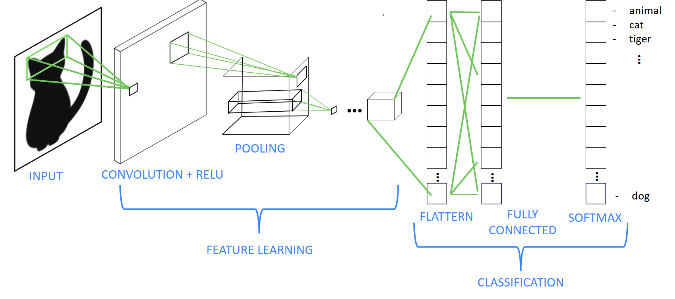
Convolutional Layers: Extract features from images.
Pooling Layers: Reduce dimensionality.
Fully Connected Layers: Make predictions based on extracted features.
Note: CNNs are great for detecting patterns in images using convolutional layers. Pooling layers reduce computation, making models faster.
Notes:
CNNs are great for detecting patterns in images using convolutional layers. Pooling layers reduce computation, making models faster.

Slide 12
How do CNNs work?

Slide 13
How do CNNs work?
CNNs are composed of several layers, each with its specific purpose.
Input Layer: Takes in the raw image data.
Convolutional Layer: Extracts features from the input image using filters.
Activation Layer (ReLU): Introduces non-linearity into the model.
Pooling Layer: Reduces the spatial size of the feature maps, making the model more efficient.
Fully Connected Layer: Combines all the features to make the final prediction.
Output Layer: Produces the final classification result (e.g., cat, dog, car).

Slide 14
Step-by-Step

Slide 15
Step 1: Input Layer
The input to a CNN is an image represented as a matrix of pixel values.
A color image typically has three channels (Red, Green, Blue) and can be represented as a 3D matrix: height x width x channels.
For example, a 32x32 color image has a shape of (32, 32, 3).
3 Color Channels
4 | 6 | 1 | 3
0
2
1
9 | 7 | 3 | 2
26
15
8
35 | 19 | 25 | 6
13 | 22 | 16 | 53
4 | 3 | 7 | 10
0 | 8 | 1 | 3
Height: 32 Units
(Pixels)
Width: 32 Units
(Pixels)

Slide 16
Step 2: Convolutional Layer
The first layer in a CNN is usually a convolutional layer.
This layer applies small filters (kernels) over the input image to extract features like edges, textures, or patterns.
A filter (3x3 matrix) slides over the input image, performing a dot product with the pixels to produce a feature map (also known as an activation map).
Notes:
Purpose: Extract features like edges, textures, and patterns from the input image.
Process: Filters (e.g., 3x3) slide over the image, performing a dot product to generate feature maps (activation maps).
Example: A 3x3 filter on a 5x5 image detects patterns such as vertical or horizontal edges.
Multiple Filters: Used to extract diverse features.

Slide 17
The filter slides over the image and extracts patterns like vertical or horizontal edges.
This process is repeated with multiple filters to extract different features.
2 | 4 | 7 | 6 | 5
9 | 7 | 1 | 2 | 6
8 | 3 | 4 | 5 | 7
4 | 3 | 3 | 8 | 4
5 | 2 | 1 | 1 | 2
1 | 0 | -1
1 | 0 | -1
1 | 0 | -1
3 x 3 filter
5 x 5 Input Image
Notes:
Purpose: Extract features like edges, textures, and patterns from the input image.
Process: Filters (e.g., 3x3) slide over the image, performing a dot product to generate feature maps (activation maps).
Example: A 3x3 filter on a 5x5 image detects patterns such as vertical or horizontal edges.
Multiple Filters: Used to extract diverse features.

Slide 18
The stride determines how much the filter moves at each step (e.g., stride of 1 moves one pixel at a time).
Padding adds a border of zeros around the input to keep the output size the same as the input.
stride 1
(Image with Stride)
0 | 0 | 0
0
0
0 | 0 | 0 | 0 | 0 | 0 | 0
0 |  |  |  |  |  | 0
0 |  |  |  |  |  | 0
0 |  |  |  |  |  | 0
0 |  |  |  |  |  | 0
0 |  |  |  |  |  | 0
0 | 0 | 0 | 0 | 0 | 0 | 0
(With Padding)

Slide 19
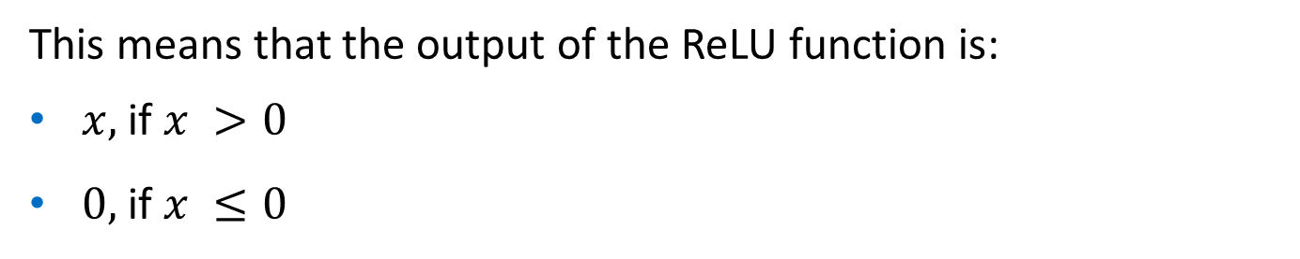
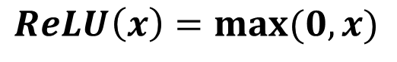
Step 3: Activation Function (ReLU)
After the convolution operation, an activation function is applied to introduce non-linearity.
The most common activation function is ReLU (Rectified Linear Unit), which replaces all negative values with zero.
ReLU helps the model learn complex patterns and speeds up training.
$$ReLU\left(x\right)=max⁡(0, x)$$
This means that the output of the ReLU function is:
$x,$if $x >0$
$0,$ if $x ≤0$
Notes:
About ReLU and it’s formula and why use ReLU.

Slide 20
Step 4: Pooling Layer (Max Pooling)
The Pooling Layer reduces the spatial dimensions (height and width) of the feature maps, keeping only the most important information.
Max Pooling is the most common type, which selects the maximum value from each region covered by the filter.
Notes:
Reduces spatial dimensions (height & width) of feature maps.
Max Pooling: Selects the max value from each region (e.g., 2×22 \times 22×2 filter, stride 2).
Benefits: Simplifies data, lowers computational cost, prevents overfitting.

Slide 21
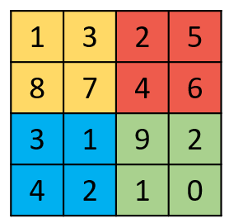
If you use a 2x2 filter with a stride of 2, the pooling layer takes the maximum value in each 2x2 block and reduces the size of the feature map.
This reduces computational complexity and helps prevent overfitting.
1 | 3 | 2 | 5
8 | 7 | 4 | 6
3 | 1 | 9 | 2
4 | 2 | 1 | 0
Max( ) = 8
Max( ) = 6
8 | 6
4 | 9
Max( ) = 4
Max( ) = 9
Notes:
Reduces spatial dimensions (height & width) of feature maps.
Max Pooling: Selects the max value from each region (e.g., 2×22 \times 22×2 filter, stride 2).
Benefits: Simplifies data, lowers computational cost, prevents overfitting.

Slide 22
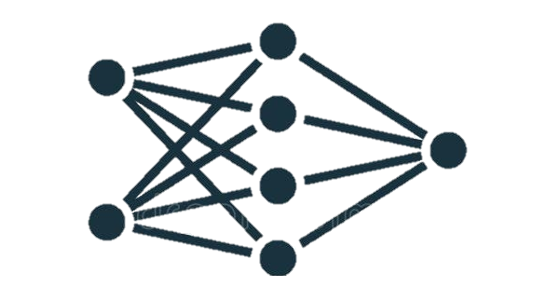
Step 5: Fully Connected Layer (Dense Layer)
After several convolutional and pooling layers, the feature maps are flattened into a 1D vector.
This vector is fed into a Fully Connected Layer where each neuron is connected to every neuron in the previous layer.
The fully connected layer learns to combine the extracted features to make predictions.
Fully Connected Layer
Notes:
Feature maps are flattened into a 1D vector.
Each neuron connects to all neurons in the previous layer.
Combines extracted features to make predictions.

Slide 23
Step 6: Output Layer
The Output Layer produces the final prediction using an activation function like Softmax (for multi-class classification) or Sigmoid (for binary classification).
The result could be a label (e.g., "cat", "dog") or a probability distribution over classes.
Softmax | Sigmoid
Decide who (“cat”, “dog”) gets how many percentage. | Decide between two things.
Shares everything equally (100%). | Only One, Just yes or no likelihood
Works for 2+ options (Cat, Dog, Rabbit, etc.,) | Works for 1 option (yes/no decision)
Notes:
Produces final prediction using Softmax (multi-class) or Sigmoid (binary).
Result: A label (e.g., "cat", "dog") or a probability distribution over classes.

Slide 24
Practical Applications of CNNs
Image Classification: Recognizing objects in images (cats, dogs, cars).
Object Detection: Detecting and localizing multiple objects within an image (YOLO, SSD).
Face Recognition: Identifying people from photos (Face ID).
Medical Imaging: Detecting diseases from X-rays, MRIs, or CT scans.
Self-Driving Cars: Understanding the environment through camera feeds to make driving decisions.
Video Analysis: Analyzing video frames to detect actions or events.

Slide 25
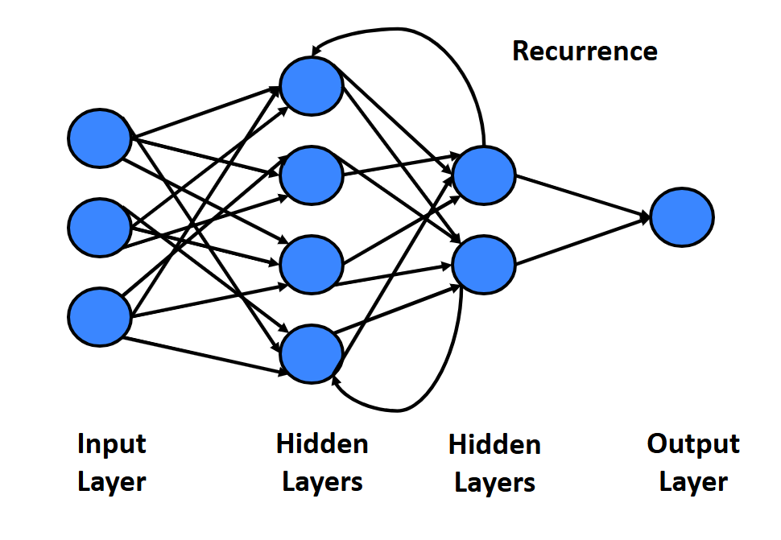
Understanding RNNs
How RNNs Work: Information flows in a loop, making them suitable for sequential data.
Use Cases: Language translation, sentiment analysis, and stock price prediction.

Slide 26


Realistic Infotech Group
IT Training & Services
No.79/A, First Floor
Corner of Insein Road and Damaryon Street
Quarter (9), Hlaing Township
Near Thukha Bus Station
09256675642, 09953933826
http://www.rig-info.com

